Slide 1

“Treating Care Experience as a Protected Characteristic
Workshop”
®
Resource for facilitators
©Care Leaver Offer

Slide 2
1. Introduction
(10 minutes)
Welcome and Icebreaker Activity: Encourage participants to introduce themselves and share one thing they wish others knew about care-experienced young people.
Briefly explain the purpose of the workshop: Understanding protected characteristics and how they might apply to care-experienced youth if the law was changed.
®

Slide 3
2. Understanding Protected Characteristics
(15 minutes)
Definition and Examples: Explain what protected characteristics are, including examples such as age, disability, gender reassignment, marriage and civil partnership, pregnancy and maternity, race, religion or belief, sex, and sexual orientation.
Interactive Activity: Use a case study or scenario to demonstrate protected characteristics in action.
®

Slide 4
3. Direct and Indirect Discrimination
(15 minutes)
Explanation: Define and provide examples of both direct and indirect discrimination.
Interactive Activity: Participants analyse given scenarios to identify instances of direct and indirect discrimination.
®

Slide 5
4. Protected Characteristics and Care-Experienced Youth
(15 minutes)
Hypothetical Discussion: Lead a conversation on how the law might change to include care-experienced status as a protected characteristic. Discuss the potential benefits and challenges of such a change.
Group Activity: Participants brainstorm and share how such a change might personally affect them or others in their community.
®

Slide 6
5. Conclusion and Q&A
(5 minutes)
Summary: Recap the key points from the workshop.
Introduce the motions that are going through councils
Q&A: Open up the floor for any questions or comments.
®

Slide 7

6. Protected Characteristics Motion
that this Council will treat care experience as if it were a Protected Characteristic so that future services and policies made and adopted by the Council should be assessed through Equality Impact Assessments to determine the impact of changes on people with care experience, alongside those who formally share a Protected Characteristic;
that in the delivery of the Public Sector Equality Duty the Council includes care experience in the publication and review of Equality Objectives and the annual publication of information relating to people who share a Protected Characteristic in services and employment;
to formally call upon all other bodies to treat care experience as a Protected Characteristic until such time as it may be introduced by legislation;
to formally call upon all other bodies to adopt corporate parenting for children in care and care leavers until such time as it may be introduced by legislation;
for the Council to proactively seek out and listen to the voices of care experienced people when developing new policies based on their views.
Notes:
We need as many councils as possible to pass the motions
We need to get this onto the agenda at Party Conference
The key components are; That it is resolved to treat care experience as if it were a protected characteristic – That’s a none negotiable.

Slide 8
7. Councils that have passes the motion.. so far
Cumberland (29/07/2022)
Westmorland and Furness (28/09/2022)
Ashfield District Council (29/09/2022)
Manchester (05/10/2022)
Redcar and Cleveland (13/10/2022)
Bournemouth, Christchurch and Poole (14/12/2022)
Edinburgh (24/11/2022)
Wigan (07/12/2022)
Nottingham (10/01/2023)
Southend on sea Borough Council (12/01/2023)
Nottinghamshire (19/01/2023)
Sefton (19/01/2023)
Lambeth (25/01/2023)
Sunderland Council (25/01/2023)
London borough of Sutton (20/02/2023)
Lancashire (23/02/2023)
Doncaster (27/02/2023)
Telford and Wrekin (02/03/2023
Newark and Sherwood (09/03/2023)
Bradford City Council (14/03/2023)
Southampton (15/03/2023)
Salford City Council (15/03/2023)
Oldham Council (15/03/2023)
Trafford Council (15/03/2023
Plymouth City Council (27/03/2023)
North Ayrshire (29/03/2023)
Birmingham City Council (18/04/2023)
Ealing (25/04/2023)
Waltham (27/04/2023)
Cambridgeshire County Council (16/05/2023)
Somerset Council (24/05/2023)

Slide 9
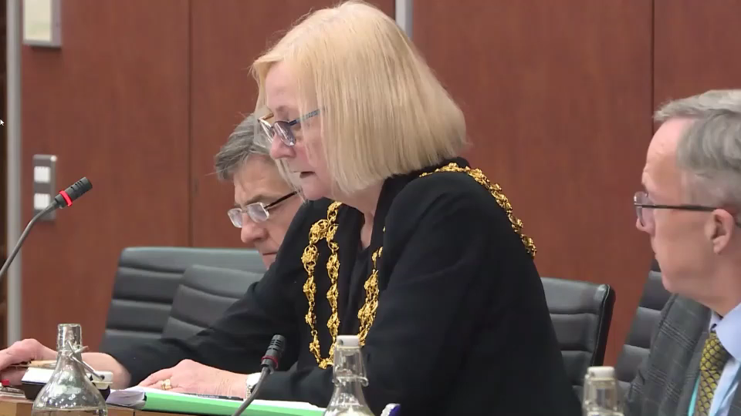
Precious and Penelope – Oldham Council

Slide 10
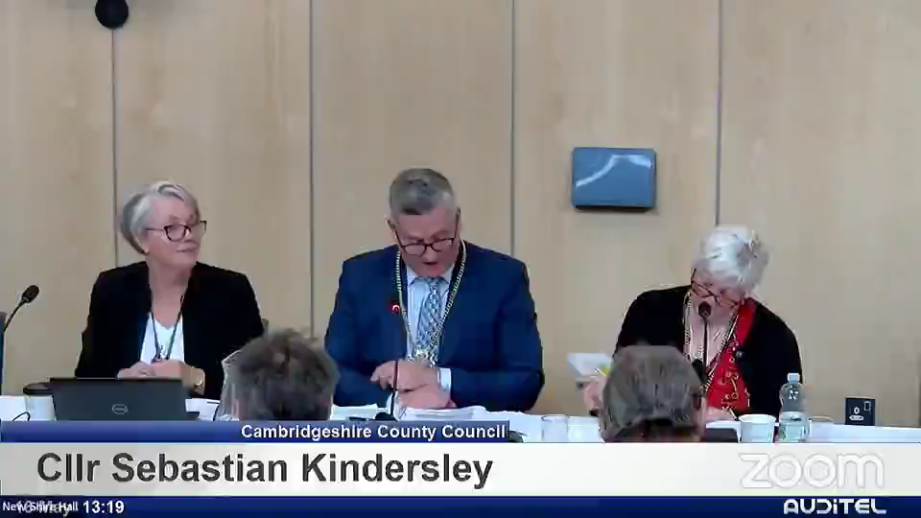
Ele Johnson – Cambridgeshire County Council

Slide 11
8. Summary and Q&A
(5 minutes)
Summary: Recap the key points from the workshop.
Q&A: Open up the floor for any questions or comments.
Vote on whether to propose a motion to local council.
®

